Slide 1
Data Structure and Algorithm (CS-102)
Dr. Manmath Narayan Sahoo
Dept. of CSE, NIT Rourkela

Slide 2
Binary Expression Tree (Application of Binary Tree)
It is a special kind of binary tree in which:
1. Each leaf node contains a single operand
2. Each nonleaf node contains a single binary operator
3. The left and right subtrees of an operator node represent subexpressions that must be evaluated before applying the operator at the root of the subtree.

Slide 3
A Four-Level Binary Expression
‘*’
‘-’
‘/’
‘8’
‘5’
‘+’
‘3’
‘4’
‘2’

Slide 4
Levels Indicate Precedence
The levels of the nodes in the tree indicate their relative precedence of evaluation (we do not need parentheses to indicate precedence).
Operations at higher levels of the tree are evaluated later than those below them.
The operation at the root is always the last operation performed.

Slide 5
A Binary Expression Tree
‘*’
‘+’
‘3’
‘4’
‘2’
What value does it have?
( 4 + 2 ) * 3 = 18

Slide 6
Easy to generate the infix, prefix, postfix expressions (how?)
‘*’
‘-’
‘/’
‘8’
‘5’
‘+’
‘3’
‘4’
‘2’
Infix: ( ( 8 - 5 ) * ( ( 4 + 2 ) / 3 ) )
Prefix: * - 8 5 / + 4 2 3
Postfix: 8 5 - 4 2 + 3 / *

Slide 7
Binary Search Tree (BST)
Suppose T is a binary tree
Then T is called binary search tree if each node N of T has the following property
The value at N is greater than every value in the left sub-tree of N and is less than every value in the right sub-tree of N

Slide 8
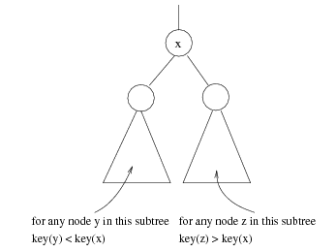
x

Slide 9
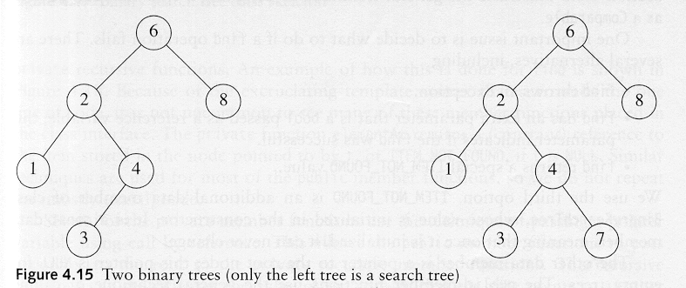
Binary Search Trees
A binary search tree
Not a binary search tree

Slide 10
Searching and Inserting in BST
Algorithm to find the location of ITEM in the BST T or insert ITEM as a new node in its appropriate place in the tree
[a] Compare ITEM with the root node N of the tree
(i) If ITEM < N, proceed to the left child of N
(ii) If ITEM > N, proceed to the right child of N

Slide 11
Searching and Inserting in BST
[b] Repeat Step (a) until one of the following occurs
(i) We meet a node N such that ITEM = N. In this case search is successful
(ii) We meet an empty sub-tree, which indicates that search is unsuccessful and we insert ITEM in place of empty subtree

Slide 12
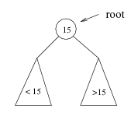
Searching BST
If we are searching for 15, then we are done.
If we are searching for a key < 15, then we should search in the left subtree.
If we are searching for a key > 15, then we should search in the right subtree.

Slide 13
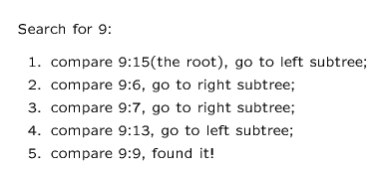
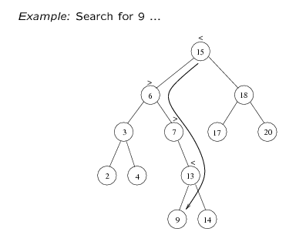

Slide 14
Insert 40, 60, 50, 33, 55, 11 into an empty BST
40
40
40
40
60
60
33
60
1. ITEM = 40
50
50
2. ITEM = 60
3. ITEM = 50
4. ITEM = 33

Slide 15
Insert 40, 60, 50, 33, 55, 11 into an empty BST
40
40
60
33
60
33
50
11
50
55
55
5. ITEM = 55
6. ITEM = 11

Slide 16
Locating an ITEM
A binary search tree T is in memory and an ITEM of information is given. This procedure finds the location LOC of ITEM in T and also the location of the parent PAR of ITEM.

Slide 17
Locating an ITEM
Three special cases:
[1] LOC == NULL and PAR == NULL, tree is empty
[2] LOC ≠ NULL and PAR == NULL, ITEM is the root of T
[3] LOC == NULL and PAR ≠ NULL, ITEM is not in T and can be added to T as child of the node N with location PAR.

Slide 18
FIND(INFO,LEFT,RIGHT,ROOT,ITEM,LOC,PAR)
[1] [Tree empty ?]
If ROOT == NULL, then
Set LOC = NULL, PAR = NULL, Exit
[2] [ITEM at root ?]
If ROOT→INFO == ITEM, then
Set LOC = ROOT, PAR = NULL, Exit
[3] [Initialize pointer PTR and SAVE]
If ITEM < ROOT→INFO then
Set PTR = ROOT→LEFT, SAVE = ROOT
Else
Set PTR = ROOT→RIGHT, SAVE =ROOT

Slide 19
[4] Repeat Step 5 and 6 while PTR ≠ NULL
[5] [ITEM Found ?]
If ITEM == PTR→INFO, then
Set LOC = PTR, PAR = SAVE, Exit
[6] If ITEM < PTR→INFO, then
Set SAVE = PTR, PTR = PTR→LEFT
Else
Set SAVE = PTR, PTR = PTR→RIGHT
[7] [Search Unsuccessful]
Set LOC = NULL, PAR = SAVE
[8] Exit

Slide 20
40
33
60
11
50
55

Slide 21
A binary search Tree T is in memory and an ITEM of information is given. Algorithm to find the location LOC of ITEM in T or adds ITEM as a new node in T at location LOC.

Slide 22
[1] Call FIND(INFO, LEFT,RIGHT,ROOT,ITEM,LOC,PAR)
[2] If LOC ≠ NULL, then Exit
[3] [Copy the ITEM into the node NEW]
(a) Create a node NEW
(b) NEW→INFO = ITEM
( c) Set LOC = NEW,
NEW→LEFT = NULL, NEW→RIGHT = NULL

Slide 23
[4] [Add ITEM to tree]
If PAR = NULL
Set ROOT = NEW
Else
If ITEM < PAR→INFO, then
Set PAR→LEFT = NEW
Else
Set PAR→RIGHT = NEW
[5] Exit

Slide 24
Binary Search Tree
Insert Algorithm
If value we want to insert < key of current node, we have to go to the left subtree
Otherwise we have to go to the right subtree
If the current node is empty (not existing) create a node with the value we are inserting and place it here.

Slide 25
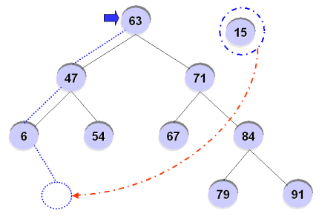
Binary Search Tree
For example, inserting ’15’ into the BST?

Slide 26
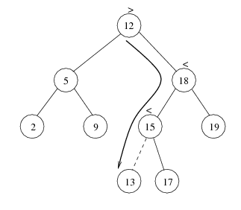

Slide 27
Deletion from BST
T is a binary tree. Delete an ITEM from the tree T
Deleting a node N from tree depends primarily on the number of children of node N

Slide 28
Deletion
There are three cases in deletion
Case 1. N has no children. N is deleted from the T by replacing the location of N in the parent node of N by null pointer
40
33
60
11
50
55
ITEM = 11

Slide 29
Deletion
Case 2. N has exactly one child. N is deleted from the T by simply replacing the location of N in the parent node of N by the location of the only child of N
40
33
60
11
50
55
ITEM = 50

Slide 30
Deletion
Case 2.
40
33
60
11
55
ITEM = 50

Slide 31
Deletion
Case 3. N has two children. Let S(N) denote the in-order successor of N. Then N is deleted from the T by first deleting S(N) from T and then replacing node N in T by the node S(N)
40
33
60
11
50
55
ITEM = 40

Slide 32
Deletion
Case 3.
40
50
33
60
33
60
11
55
11
55
Delete 50
Replace 40 by 50

Slide 33
Types of Binary Trees
Degenerate – only one child
Balanced – mostly two children
Complete – always two children
Degenerate binary tree
Balanced binary tree
Complete binary tree

Slide 34
Binary Trees Properties
Degenerate
Height = O(n) for n nodes
Similar to linear list
Balanced
Height = O( log(n) ) for n nodes
Useful for searches
Degenerate binary tree
Balanced binary tree

